Slide 1
Web Development with Java

Slide 2
Outline
Servlet
JSP – Java Server Page
Java Beans
ORM (Object Relational Mapping)

Slide 3
Java Servlets
A servlet is a Java program that is invoked by a web server in response to a request
Server Platform
Client
Web
Server
Web Application
Servlet

Slide 4
Java Servlets
Together with web pages and other components, servlets constitute part of a web application
Servlets can
create dynamic (HTML) content in response to a request
handle user input, such as from HTML forms
access databases, files, and other system resources
perform any computation required by an application
Notes:
constitute: cấu thành, tạo thành

Slide 5

Java Servlets
Servlets are hosted by a servlet container, such as Apache Tomcat*
*Apache Tomcat can be both a web server and a servlet container
Server Platform
The web server
handles the HTTP
transaction details
Web
Server
The servlet container
provides a Java
Virtual Machine
for servlet execution
Servlet
Container

Slide 6
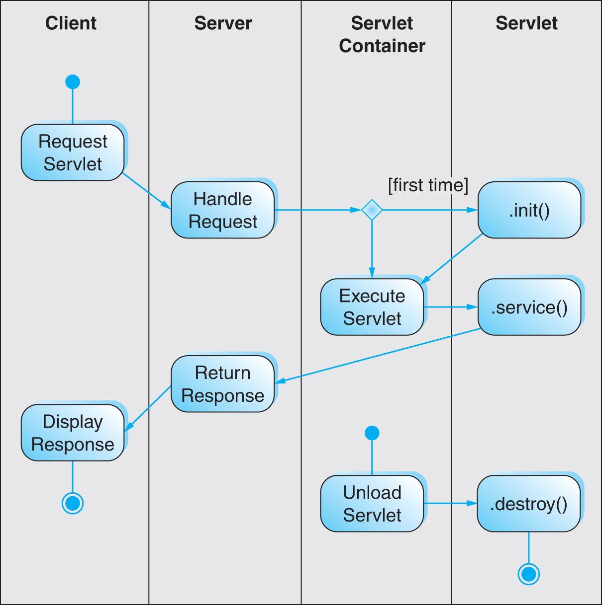
Servlet Operation

Slide 7
Servlet Methods
Servlets have three principal methods
.init() invoked once, when the servlet is loaded by the servlet container (upon the first client request)
.service(HttpServletRequest req, HttpServletResponse res)
invoked for each HTTP request parameters encapsulate the HTTP request and response
.destroy()
invoked when the servlet is unloaded (when the servlet container is shut down)
Notes:
- upon: theo, với, nhờ

Slide 8
Servlet Methods
The default .service() method simply invokes method-specific methods
depending upon the HTTP request method
.doGet()
.doPost()
.doHead()
… etc.
.service()

Slide 9
HTTP Servlet
Methods of HttpServlet and HTTP requests
All methods take two arguments: an HttpServletRequest object and an HttpServletResponse object.
Return a BAD_REQUEST (400) error by default.
Methods | HTTP Requests | Comments
doGet | GET, HEAD | Usually overridden
doPost | POST | Usually overridden
doPut | PUT | Usually not overridden
doOptions | OPTIONS | Almost never overridden
doTrace | TRACE | Almost never overridden
Notes:
overridden: ghi đè

Slide 10
Servlet Example 1
This servlet will say "Hello!" (in HTML)
package servlet;
import javax.servlet.http.*;
public class HelloServlet extends HttpServlet {
public void service(HttpServletRequest req,
HttpServletResponse res) throws IOException {
PrintWriter htmlOut = res.getWriter();
res.setContentType("text/html");
htmlOut.println("<html><head><title>" +
"Servlet Example Output</title></head><body>" +
"<p>Hello!</p>" + "</body></html>");
htmlOut.close();
}
}

Slide 11
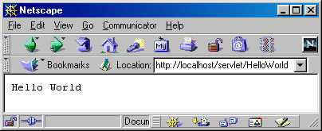
Servlet Example 2
This servlet also will say "Hello World" (not in HTML)
import java.io.*;
import javax.servlet.*;
import javax.servlet.http.*;
public class HelloWorld extends HttpServlet {
public void doGet(HttpServletRequest request,
HttpServletResponse response)
throws ServletException, IOException {
PrintWriter out = response.getWriter();
out.println("Hello World");
}
}

Slide 12
Servlet Configuration
The web application configuration file, web.xml, identifies servlets and defines a mapping from requests to servlets
<servlet>
<servlet-name>HelloServlet</servlet-name>
<servlet-class>servlet.HelloServlet</servlet-class>
</servlet>
<servlet-mapping>
<servlet-name>HelloServlet</servlet-name>
<url-pattern>/hello</url-pattern>
</servlet-mapping>
An identifying name for the servlet (appears twice)
The servlet's package
and class names
The pathname used to invoke the servlet
(relative to the web application URL)

Slide 13
Environment Entries
Servlets can obtain configuration information at run-time from the configuration file (web.xml)
a file name, a database password, etc.
in web.xml:
<env-entry-description>password</env-entry-description>
<env-entry>
<env-entry-name>UserId</env-entry-name>
<env-entry-value>Xy87!fx9*</env-entry-value>
<env-entry-type>java.lang.String</env-entry-type>
</env-entry>

Slide 14
Environment Entries
in the init() method of the servlet:
try {
Context envCtx = (Context) (new InitialContext()).lookup("java:comp/env");
password = (String) envCtx.lookup("password");
} catch (NamingException e) {
e.printStackTrace();
} catch (ClassNotFoundException e) {
e.printStackTrace();
}

Slide 15
Handling HTML Forms
An HTML form can be sent to a servlet for processing
The action attribute of the form must match the servlet URL mapping
<form method="post" action="hello" />
<servlet-mapping>
<servlet-name>HelloServlet</servlet-name>
<url-pattern>/hello</url-pattern>
</servlet-mapping>

Slide 16
Simple Form Servlet
<form action="hello" method="post" >
<p>User Id:<input type="text" name="userid" /></p>
<p><input type="submit" value="Say Hello" /></p>
</form>
public class HelloServlet extends HttpServlet {
public void doPost(HttpServletRequest req,
HttpServletResponse res) throws IOException {
PrintWriter out = res.getWriter();
res.setContentType("text/html");
String userId = req.getParameter("userid");
out.println("<html><head><title>Hello</title></head>"
+ "<body><p>Hello, " + userId
+ "!</p></body></html>");
out.close();
}

Slide 17
State Management
session: a series of transaction between user and application
session state: the short-term memory that the application needs in order to maintain the session
e.g., shopping cart, user-id
cookie: a small file stored by the client at the instruction of the server
Notes:
- Instruction: chỉ thị

Slide 18
Cookies
The Set-Cookie: header in an HTTP response instructs the client to store a cookie
Set-Cookie: SESSIONID=B6E98A; Path=/slms; Secure
After a cookie is created, it is returned to the server in subsequent requests as an HTTP request Cookie: header
Cookie: SESSIONID=B6E98A
Notes:
- subsequent: (sắpssiquent): theo sau

Slide 19
Cookie Attributes
Name: the unique name associated with the cookie
Content: value stored in the cookie
Expiration Date: cookie lifetime
Domain: Defines the hosts to which the cookie should be returned
Path: Defines the resource requests with which the cookie should be returned
Secure: if true, cookie is returned only with HTTPS requests

Slide 20
Cookie Example
Name: session-id
Content: 104-1898635-929144
Expiration Date: Monday, June 29, 2009 3:33:30 PM
Domain: .ehsl.org
Path: /slms
Secure: no
This cookie will be returned with all requests matching *.ehsl.org/slms*, through the indicated expiration date

Slide 21
Session Management
HTTP is inherently stateless, i.e., there is no memory between transactions
Applications must maintain a session memory if it is required
Cookies are used to identify sessions, by recording a unique session-id
Notes:
- inherently (inhiơrơntli): vốn đã

Slide 22
State Management
Server
Client
Session
Memory
Cookie
[session-id]
session
At the start of a new session, the server sets a new cookie containing the session-id
With each transaction, the client sends the session-id, allowing the server to retrieve the session

Slide 23
Session Attributes
The methods session.setAttribute(key, value) session.getAttribute(key) store and retrieve session memory
key is a string; value can be any object
For example,
session.setAttribute("userid", userId);
String userId = (String)session.getAttribute("userid");

Slide 24
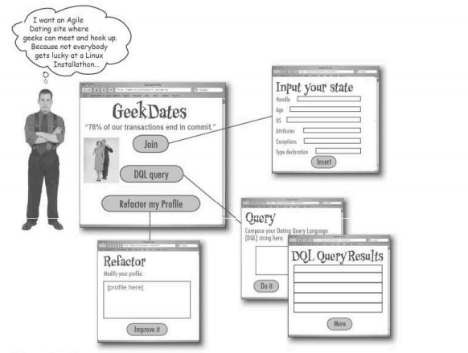
Problem

Slide 25
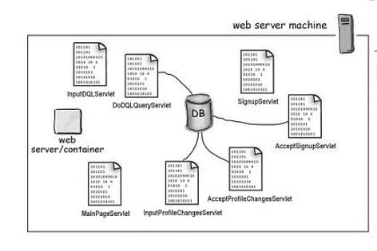
Initial Solution
Develop a number of servlets
Each servlet plays the role of one function (a.k.a business logic)

Slide 26
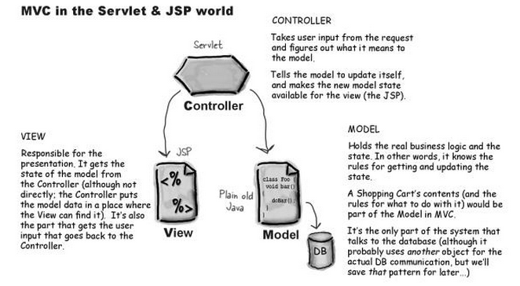
Better Solution: Using MVC
Take business logic out servlets and put them inside Model

Slide 27
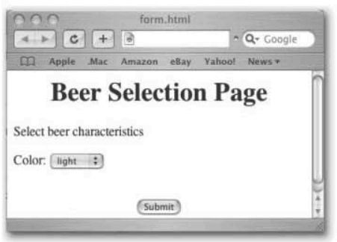
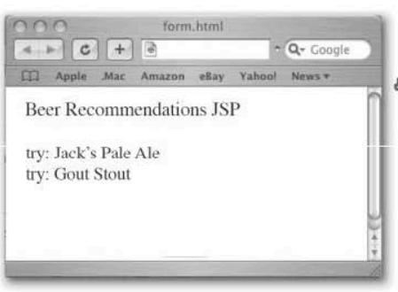
Example 1: Beer Recommendation
HTML page
JSP page

Slide 28
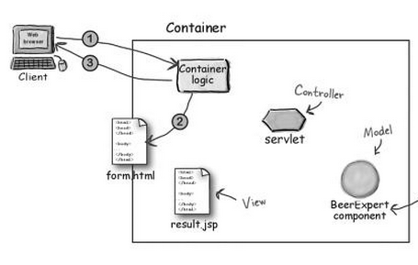
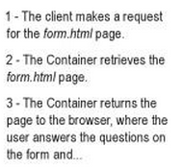
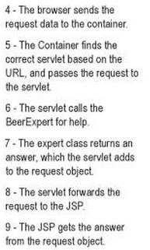
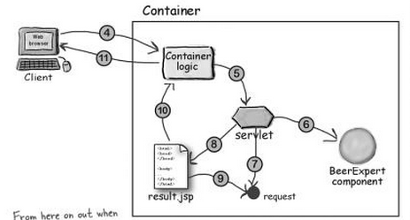

Slide 29
Application Programming Structure
beer_v1
src
web
com
form.html
result.html
WEB-INF
example
web.xml
web
model
BeerSelect
.java
BeerExpert
.java
Notes:
So this is an example directory structure of hello1 web application you find in the Java WSDP. There are two servlet Java source files. And there is a web directory called web which contains WEB-INF directory and other static resource files.
You will code each web component in the src directory.

Slide 30
Structure of Folder Development
beer_v1
webapps
tomcat
WEB-INF
form.html
result.html
classes
com
web.xml
example
web
model
BeerSelect
.class
BeerExpert
.class
Notes:
So this is an example directory structure of hello1 web application you find in the Java WSDP. There are two servlet Java source files. And there is a web directory called web which contains WEB-INF directory and other static resource files.
You will code each web component in the src directory.

Slide 31
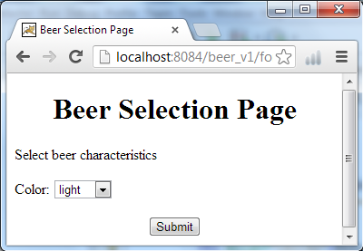
form.html
<form method="POST”
action="SelectBeer.do">
Select beer characteristics
<p>Color:
<select name="color" size="1">
<option value="light">light</option>
<option value="amber">amber</option>
<option value="brown">brown</option>
<option value="dark">dark</option>
</select>
<center> <input type="SUBMIT"> </center>
</form>

Slide 32
web.xml
<?xml version="1.0" encoding="UTF-8"?>
<web-app …>
<servlet>
<servlet-name>ServletBeer</servlet-name>
<servlet-class>com.example.web.BeerSelect
</servlet-class>
</servlet>
<servlet-mapping>
<servlet-name>ServletBeer</servlet-name>
<url-pattern>/SelectBeer.do</url-pattern>
</servlet-mapping>
</web-app>

Slide 33
Servlet BeerSelect – Version 1
public class BeerSelect extends HttpServlet {
@Override
protected void doPost(HttpServletRequest request, HttpServletResponse response) throws ServletException, IOException {
response.setContentType("text/html");
PrintWriter out = response.getWriter();
out.println("Beer Selection Advice<br>");
String c = request.getParameter("color");
out.println("<br>Got beer color "+c);
}
}

Slide 34
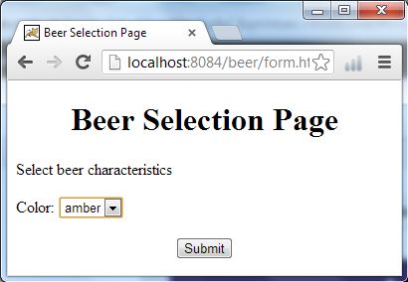
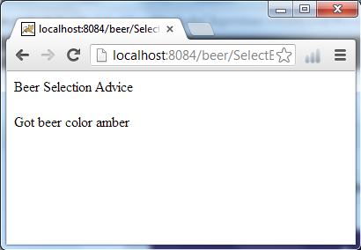
Application Test

Slide 35
Model BeerExpert
public class BeerExpert {
public List getBrands(String color){
List brands = new ArrayList();
if(color.equals("amber")){
brands.add("Jack Amber");
brands.add("Red Moose");
}
else{
brands.add("Jail Pale Ale");
brands.add("Gout Stout");
}
return brands;
}
}

Slide 36
Servlet BeerSelect – Version 2
import package com.example.web;
…
protected void doPost(HttpServletRequest request, HttpServletResponse response)
throws ServletException, IOException {
String c = request.getParameter("color");
BeerExpert be = new BeerExpert();
List result = be.getBrands(c);
response.setContentType("text/html");
PrintWriter out = response.getWriter();
out.println("Beer Selection Advice<br>");
Iterator it = result.iterator();
while(it.hasNext()){
out.print("<br>try: "+it.next());
}
}

Slide 37
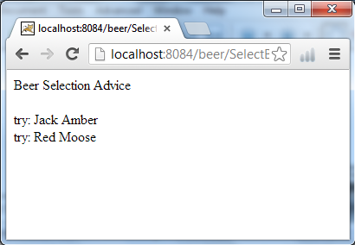
Application Test

Slide 38
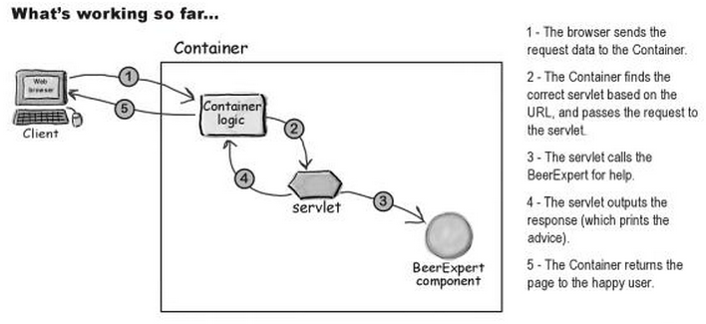
Current Architecture of the Application

Slide 39
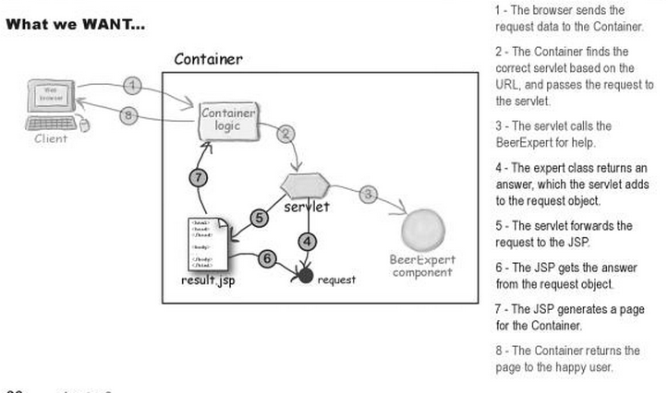
Desired Application Architecture

Slide 40
Servlet BeerSelect – Version 3
import package com.example.web;
…
protected void doPost(HttpServletRequest request, HttpServletResponse response)
throws ServletException, IOException {
String c = request.getParameter("color");
BeerExpert be = new BeerExpert();
List result = be.getBrands(c);
request.setAttribute("styles", result);
RequestDispatcher view =
request.getRequestDispatcher("result.jsp");
view.forward(request, response);
}

Slide 41
Result.jsp
<%@ page import="java.util.*"%>
<!DOCTYPE html>
<html>
<body>
<h1 align="center">Beer Recommendation </h1> <p>
<%
List styles=(List) request.getAttribute("styles");
Iterator it = styles.iterator();
while(it.hasNext()){
out.print("<br>try: "+it.next());
}
%>
</body>
</html>

Slide 42
Application Test

Slide 43
Outline
Servlet
JSP – Java Server Page
Java Beans
ORM (Object Relational Mapping)

Slide 44
Introduction and Overview
Example: Hello.jsp
<HTML>
<HEAD><TITLE>JSP Test</TITLE></HEAD>
<BODY BGCOLOR="#FDF5E6">
<H1>JSP Test</H1>
Time: <%= new java.util.Date() %>
</BODY>
</HTML>
<H1>JSP Test</H1>: normal HTML
<%, %>: special JSP tags
new java.util.Date(): java code

Slide 45
Introduction and Overview
Ingredients of a JSP
Regular HTML
Simply "passed through" to the client by the servlet created to handle the page.
JSP constructs
Scripting elements let you specify Java code that will become part of the resultant servlet,
Directives let you control the overall structure of the servlet
Actions let you specify existing components that should be used, and control the behavior of the JSP engine
JavaBeans: a type of components frequently used in JSP
Notes:
ingredient: thành phần
directive: chỉ dẫn
Resultant: xảy ra như một kết quả

Slide 46
JSP constructs - Scripting Elements
JSP converted to Servlet at first access
JSP scripting elements let you insert Java codes into the servlet results
Expressions:
Form <%= expression %>
Evaluated and inserted into the output
Scriptlets
Form <% code %>
Inserted into the servlet's service method
Declarations:
Form <%! code %>
Inserted into the body
Notes:
- expression: biểu lộ

Slide 47
JSP constructs - Scripting Elements
JSP Expressions:
Form: <%= expression %>
Example
Time: <%= new java.util.Date() %>
Processing
Evaluated, converted to a string, and inserted in the page.
At run-time (when the page is requested)

Slide 48
JSP constructs - Scripting Elements
JSP Expressions:
Several variables predefined to simply jsp expressions
request, the HttpServletRequest;
response, the HttpServletResponse;
session, the HttpSession associated with the request (if any);
out, the PrintWriter (a buffered version of type JspWriter) used to send output to the client.
Example:
Your hostname: <%= request.getRemoteHost() %>
Notes:
- If any: nếu có

Slide 49
JSP constructs - Scripting Elements
JSP Scriptlets
Form: <% code %>
Example:
<% String queryData = request.getQueryString();
out.println("Attached GET data: " + queryData); %>
Inserted into the servlet's service method EXACTLY as written
Can access the same predefined variables as JSP expressions

Slide 50
JSP constructs - Scripting Elements
JSP Declarations:
Form: <%! code %>
Example: <%! private int accessCount = 0; %>
Inserted into the main body of the servlet class (outside of the service method processing the request)
Normally used in conjunction with JSP expressions or scriptlets.
<%! private int accessCount = 0; %>
Accesses to page since server reboot:
<%= ++accessCount %>
Notes:
- conjunction: kết hợp

Slide 51
JSP constructs - JSP Directives
Affect the overall structure of the servlet class.
Form: <%@ directive attribute1="value1"
attribute2="value2"
...
attributeN="valueN" %>
Two commonly used types of directives
Page directives
<%@ page import="java.util.*" %>
Include directives
<%@ include file="/navbar.html" %>
Notes:
affect: ảnh hưởng
Include Directive
lets you include files at the time the JSP page is translated into a servlet (static including).

Slide 52
JSP constructs - Directives
Examples of Page directives
<%@ page import="java.util.*" %>
<%@ page language="java“ import="java.util.*" %>
<%@ page contentType="text/plain" %>
Same as : <% response.setContentType("text/plain"); %>
<%@ page session="true“ %>

Slide 53
JSP constructs - Directives
Include Directive
lets you include files at the time the JSP page is translated into a servlet (static including).
Form: <%@ include file="relative url" %>
Example situation where it is useful:
Same navigation bar at bottom of many pages.
Usage
Keep content of the navigation bar in an URL
Include the URL in all the pages

Slide 54
JSP constructs - Actions
JSP actions control the behavior of the servlet engine. Let one
Dynamically insert a file
Forward the user to another page
Reuse JavaBeans components
..

Slide 55
JSP constructs - Actions
The include action
Form:
<jsp:include page="relative URL" flush="true" />
Inserts the file at the time the page is requested.
Differs from the include directive, which inserts file at the time the JSP page is translated into a servlet.

Slide 56
JSP constructs - Actions
The forward action:
Form: <jsp:forward page=“relative URL" />
<jsp:forward page="<%= someJavaExpression %>" />
Forward to the page specified.
Several actions related to reuse of JavaBeans components
Discuss next

Slide 57

JSP vs Servlet
JSP
Servlets
JSP
Java-like code in HTML
Very easy to author
Code is compiled into a servlet
HTML code in Java
Not easy to author
Servlets:
Using println() to create HTML pages → Whenever developers make a change, they have to recompile and redeploy, which is not really convenient
JSP:
correct the problem of Servlet
Notes:
This is something we talked about in servlet session. Just to rehash the difference between the two technologies, let's compare them one more time here.
In servlet, the HTML generation logic is in the form of Java code while in JSP, the HTML page can be represented as HTML tags. In servlet, because HTML page has to be generated inside Java code, it is rather hard to author web pages. And JSP is designed to make this webpage authoring process easier for web page designers because they don't have to know how to write Java code in most cases.
Now I want to make sure you understand that JSP and servlet are very closely related and complementary. In fact, JSP pages are internally translated into servlet code when they get deployed. And I will talk about this aspect later on one more time.

Slide 58
Benefits of Using JSP over Servlet
Exploit both two technologies
The power of Servlet is “controlling and dispatching”
The power of JSP is “displaying”
In practice, both Servlet and JSP are very useful in MVC model
Servlet plays the role of Controller
JSP plays the role of View
Notes:
OK, we talked about benefits of using JSP over servlet.
Now some of you want to ask “Do I have to use JSP over Servlet for all my web application development?” The answer is emphatic no. The strengths and for that matter the weaknesses of these two technologies are different. That is, they are designed for different purpose. And you want to leverage the strength of each technologies in your application.
Let's talk about Servlet first. Because it gives the web application designer a great control in the form of a Java program, its strength is in the area of controlling and dispatching. For example, if you want to display a different contents depending on who is the caller or input parameter value or time of day or based on some business logic processing, it is somewhat easier to express that condition in a program. Now after controlling and dispatching is done, you can choose which HTML page (or XML or WML page) can be displayed. The strength of JSP is again displaying HTML or XML pages.
So in a typical production environment, people use servlet and JSP technologies together in a so-called MVC (Model-View-Controller) pattern, where servlet plays the role of Controller while JSP plays the role of View.

Slide 59
Outline
Servlet
JSP – Java Server Page
Java Beans
ORM (Object Relational Mapping)

Slide 60
JavaBeans
Beans
Objects of Java classes that follow a set of simple naming and design conventions
Outlined by the JavaBeans specification
Beans are Java objects
Other classes can access them and their methods
One can access them from jsp using scripting elements.
Beans are special Java objects
Can be accessed using JSP actions.
Why interesting?
Programmers provide beans and documentations
Users do not have to know Java well to use the beans.
Notes:
Một JavaBean là một lớp Java được xây dựng một cách đặc biệt trong Java và được mã hóa theo JavaBeans API Specifications.
Sau đây là các đặc trưng duy nhất giúp phân biệt một JavaBean với các lớp khác trong Java:

Slide 61
JavaBeans
Naming conventions:
Class name:
Often include the word Bean in class name, such as UserBean
Constructor:
Must implement a constructor that takes no arguments
Note that if no constructor is provided, a default no-argument constructor will be provided.

Slide 62
JavaBeans
Naming conventions: Methods
Semantically, a bean consists of a collection of properties (plus some other methods)
The signature for property access (getter and setter) methods
public void setPropertyName(PropertyType value);
public PropertyType getPropertyName()
Example:
Property called rank:
public void setRank(String rank);
public String getRank();
Property called age:
public void setAge(int age);
public int getAge();

Slide 63
JavaBeans
Property name conventions
Begin with a lowercase letter
Uppercase the first letter of each word, except the first one, in the property name.
Examples: firstName, lastName
Corresponding setter and getter methods:
setFirstName, setLastName
getFirstName, getLastName
Note the case difference between the property names and their access method

Slide 64
JavaBeans
Indexed properties
Properties whose values are sets
Conventions:
public PropertyType[] getProperty()
public PropertyType getProperty(int index)
public void setProperty(int index, PropertyType value)
public void setProperty(PropertyType[])
public int getPropertySize()
Notes:
property: thuộc tính
Whose: của ai

Slide 65
JavaBeans
Bean with indexed properties
import java.util.*;
public class StatBean {
private double[] numbers;
public StatBean() {numbers = new double[0]; }
public double getAverage() {..}
public double getSum() { .. }
public double[] getNumbers(){return numbers; }
public double getNumbers(int index)
{return numbers[index];}
public void setNumbers(double[] numbers)
{this.numbers = numbers;}
public void setNumbers(int index, double value) { numbers[index] = value;}
public int getNumbersSize()
{return numbers.length;}
}

Slide 66
JavaBeans
Boolean Properties
Properties that are either true or false
Setter/getter methods conventions
public boolean isProperty();
public void setProperty(boolean b);
public boolean isEnabled();
public void setEnabled(boolean b);
public boolean isAuthorized();
public void setAuthorized(boolean b);

Slide 67
Using Beans in JSP
JSP actions for using beans:
jsp:useBean
Find or instantiate a JavaBean.
jsp:setProperty
Set the property of a JavaBean.
Call a setter method
jsp:getProperty
Get the property of a JavaBean into the output.
Call a getter method
Notes:
- instantiate: thuyết minh/ khởi tạo

Slide 68
Using Beans in JSP
Example: The bean
package jspBean201; public class SimpleBean { private String message = "No message specified"; public String getMessage() { return(message); } public void setMessage(String message) { this.message = message; } }
Compile with javac and place in regular classpath
In Tomcat, same location as servlets. (can be different on other web servers)

Slide 69
Using Beans in JSP
Use SimpleBean in jsp: ReuseBean.jsp
Find and instantiate bean
<jsp:useBean id="test" class=“jspBean201.SimpleBean" />
Set property
<jsp:setProperty name="test" property="message" value="Hello WWW“/>
Get property: call the getMessage method and insert what it returns to web page
<H1>Message: <I>
<jsp:getProperty name="test" property="message" />
</I></H1>

Slide 70
Using Beans in JSP
The jsp:useBean action:
Format
Simple format: <jsp:useBean …/>
<jsp:useBean id="test" class=“jspBean201.SimpleBean" />
Container format: body portion executed only when bean first instantiated
<jsp:useBean ...> Body </jsp:useBean>
Notes:
portion: phần chia

Slide 71
Using Beans in JSP
The jsp:useBean action:
<jsp:useBean id=.." scope=“..”, type=“..”, beanName=“..”, class=“.." />
<jsp:useBean id="table" scope="session" class="jspBean201.TableBean" />
Scope: Indicates the context in which the bean should be made available
page (default): available only in current page
request, available only to current request
session, available only during the life of the current HttpSession
Application, available to all pages that share the same ServletContext
id: Gives a name to the variable that will reference the bean
New bean not instantiated if previous bean with same id and scope exists.
class: Designates the full package name of the bean.
type and beanName: can be used to replace the class attribute

Slide 72
Using Beans in JSP
The jsp:setProperty action:
Forms:
<jsp:setProperty name=“.." property=“.." value=".." />
<jsp:setProperty name=“.." property=“.." param=".." />
If the value attribute is used
String values are automatically converted to numbers, boolean, Boolean, byte, Byte, char, and Character
If the param attribute is used
No conversion
Notes:
conversion: quy đổi

Slide 73
Outline
Servlet
JSP – Java Server Page
Java Beans
ORM (Object Relational Mapping)

Slide 74
The Object-Oriented Paradigm
The world consists of objects
So we use object-oriented languages to write applications
We want to store some of the application objects (a.k.a. persistent objects)
So we use a Object Database?

Slide 75
The Reality of DBMS
Relational DBMS are still predominant
Best performance
Most reliable
Widest support
Bridge between OO applications and relational databases
CLI and embedded SQL (JDBC)
Object-Relational Mapping (ORM) tools
Notes:
DB2 Call Level Interface: CLI
Java JDBC là một java API được sử dụng để kết nối và thực hiện truy vấn với cơ sở dữ liệu. JDBC API sử dụng trình điều khiển jdbc để kết nối với cơ sở dữ liệu

Slide 76
Object-Relational Mapping
It is a programming technique for converting object-type data of an object oriented programming language into database tables.
Hibernate is used convert object data in JAVA to relational database tables.
What is Hibernate?
It is an object-relational mapping (ORM) solution that allows for persisting Java objects in a relational database
Open source
Development started late 2001

Slide 77
The ORM Approach
employee
Application
customer
account
ORM tool
Persistent Data Store
Oracle, MySQL, SQL Server …
Flat files, XML …

Slide 78
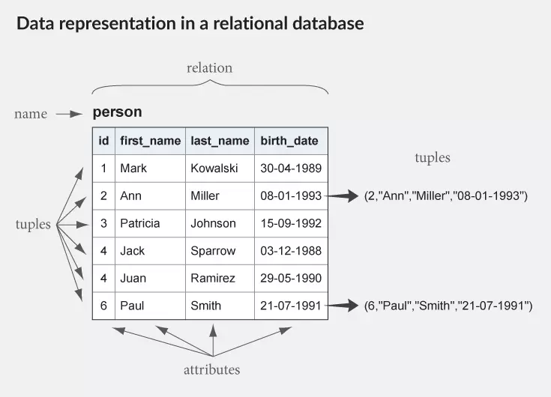

Slide 79
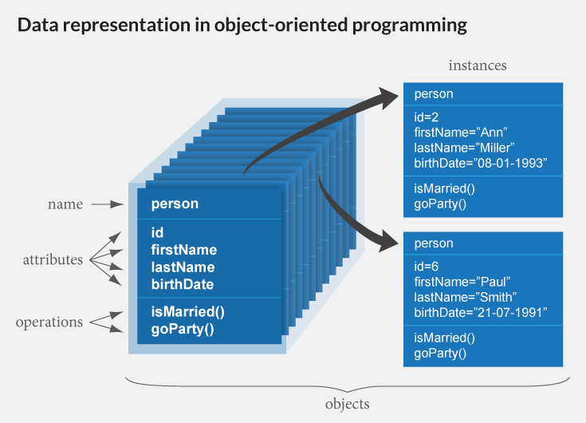

Slide 80
The ORM Approach
Normal SQL query
book_list = new List();
sql = "SELECT * FROM library WHERE author = 'Linus’”;
data = query(sql);
while (row = data.next()) {
book = new Book(); book.setAuthor(row.get('author'); book_list.add(book);
}
ORM approach
book_list = BookTable.query(author="Linus");

Slide 81
Mapping
<?xml version = "1.0" encoding = "utf-8"?> <!DOCTYPE hibernate-mapping PUBLIC "-//Hibernate/Hibernate Mapping DTD//EN" "http://www.hibernate.org/dtd/hibernate-mapping-3.0.dtd">
<hibernate-mapping>
<class name = "Employee" table = "EMPLOYEE">
<meta attribute = "class-description"> This class contains the employee detail. </meta>
<id name = "id" type = "int" column = "id">
<generator class="native"/>
</id>
<property name = "firstName" column = "first_name" type = "string"/>
<property name = "lastName" column = "last_name" type = "string"/>
<property name = "salary" column = "salary" type = "int"/> </class>
</hibernate-mapping>

Slide 82
Advantages of ORM
Make RDBMS look like ODBMS
Data are accessed as objects, not rows and columns
Simplify many common operations.
Improve portability
Use an object-oriented query language (OQL)
Separate DB specific SQL statements from application code
Object caching

